Slide 1
Urea cycle and its significance

Slide 2
Introduction
The urea cycle is the first metabolic pathway to be elucidated
The cycle is known as krebs-Henseleit urea cycle
Urea is the major end product in Nitrogen metabolism in humans and mammals.
NH₃, the product of oxidative deamination reaction, is toxic in even small amount and must be removed from the body.
Urea cycle is also known as Ornithine cycle is the conversion reactions of NH₃ into urea

Slide 3
This reaction occur in liver (certain occur in cytosol and mitochondria)
The urea is transported to the kidney where it is excreted.
The overall urea formation reaction is :-
  2 NH₃ + CO₂ + 3ATP ---> urea + H₂O + 3 ADP

Slide 4
Steps of Urea Cycle
Formation of Carbamoyl Phosphate
Synthesis of Citrulline
Synthesis of Argininosuccinate
Cleavage of Argininosuccinate
Cleavage of Arginine

Slide 5
Reactions of the urea cycle
Step | Reactants | Products | Catalyzed by | Location
1 | NH₃ + HCO₃⁻ + 2ATP | carbamoyl phosphate + 2ADP + P_{i} | CPS1 | mitochondria
2 | carbamoyl phosphate + ornithine | citrulline + P_{i} | OTC | mitochondria
3 | citrulline + aspartate + ATP | argininosuccinate + AMP + PP_{i} | ASS | cytosol
4 | argininosuccinate | Arg + fumarate | ASL | cytosol
5 | Arg + H₂O | ornithine + urea | ARG1 | cytosol

Slide 6
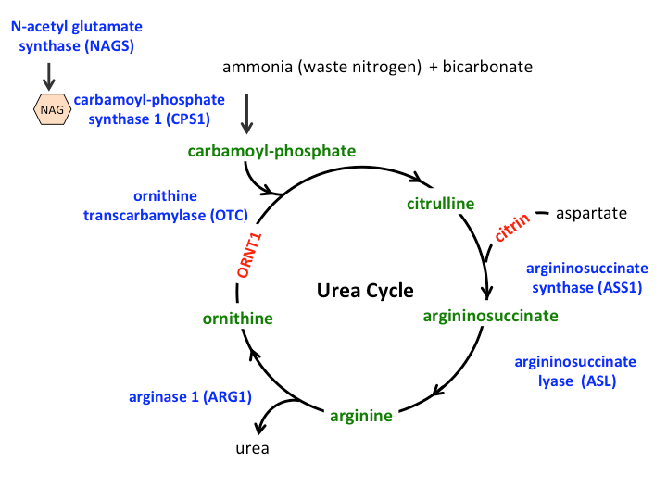

Slide 7
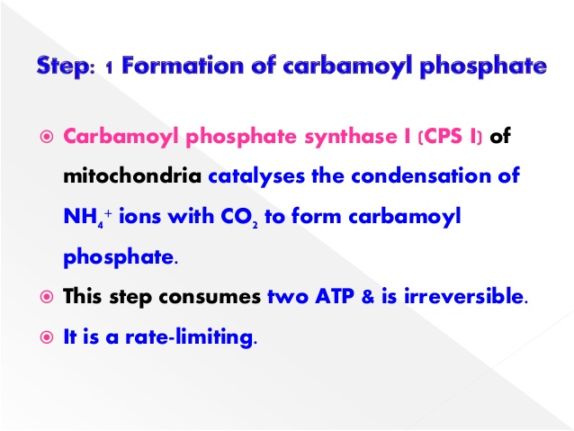

Slide 8
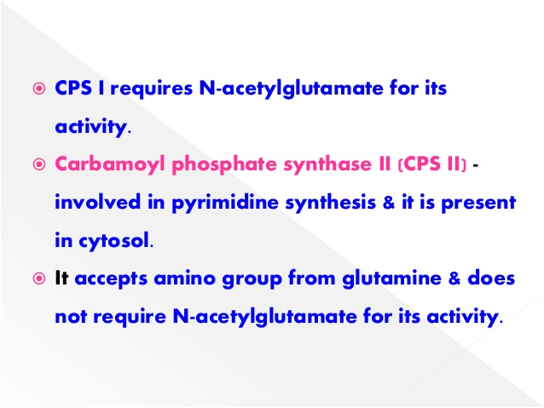

Slide 9
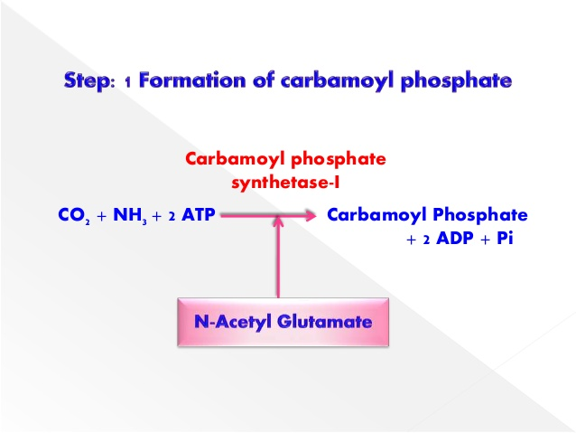

Slide 10
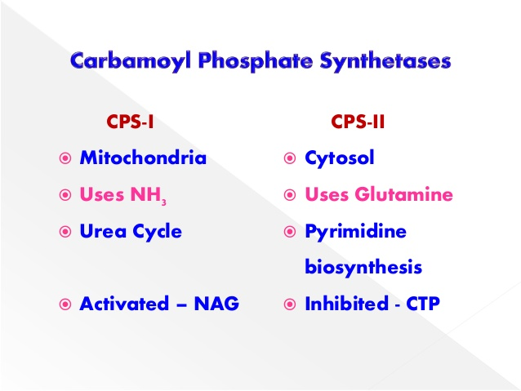

Slide 11
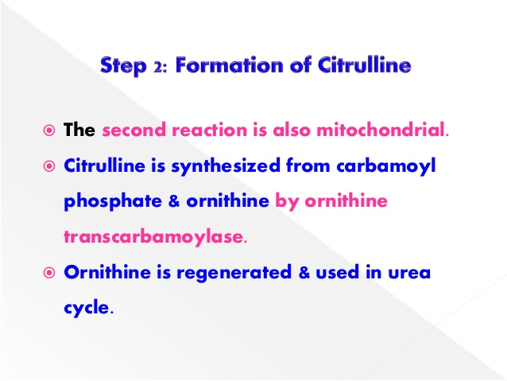

Slide 12
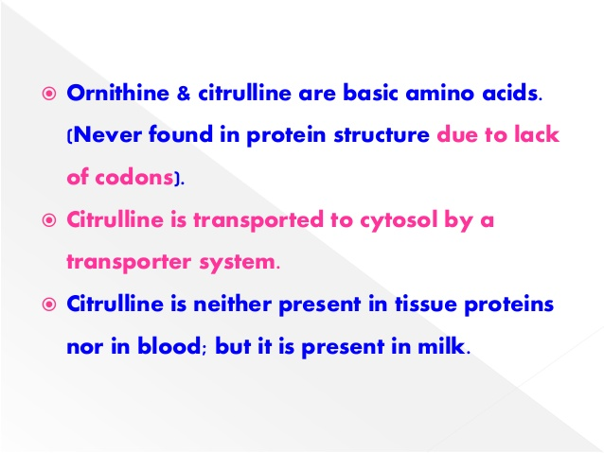

Slide 13
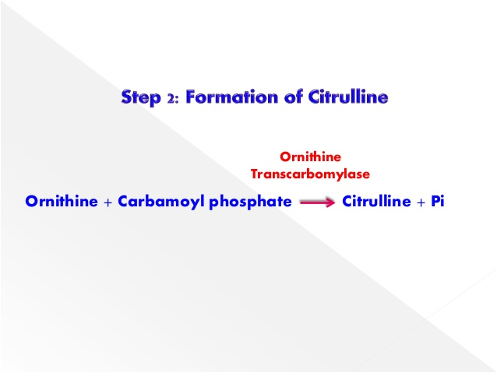

Slide 14
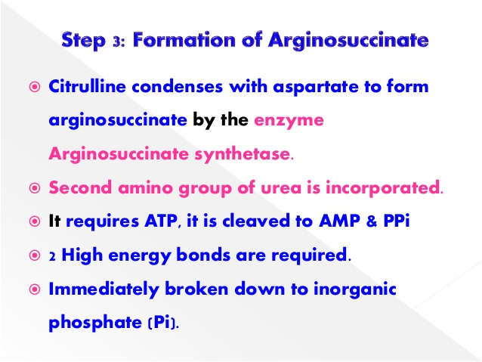

Slide 15
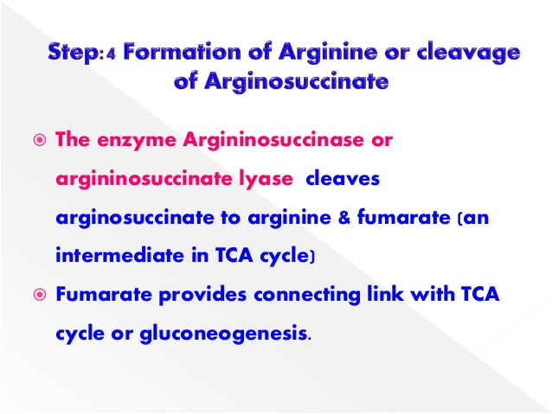

Slide 16
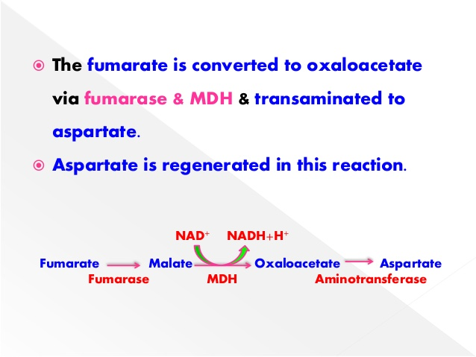

Slide 17
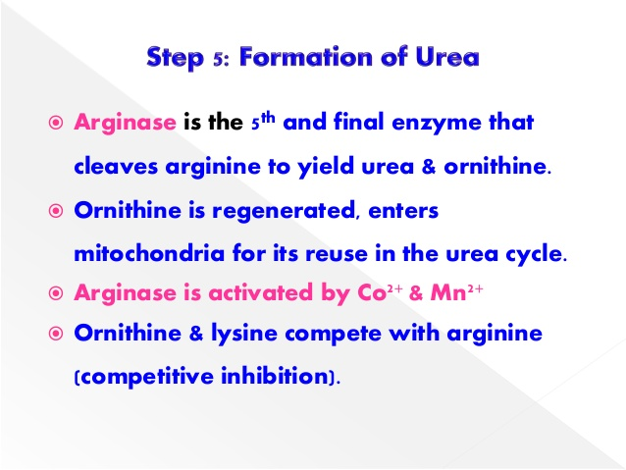

Slide 18
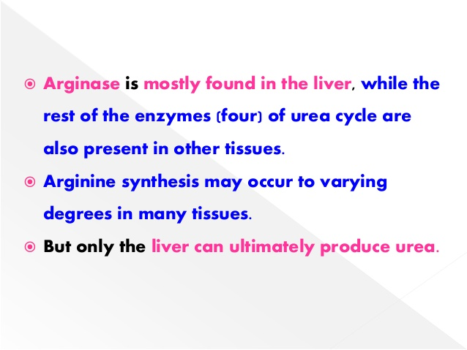

Slide 19
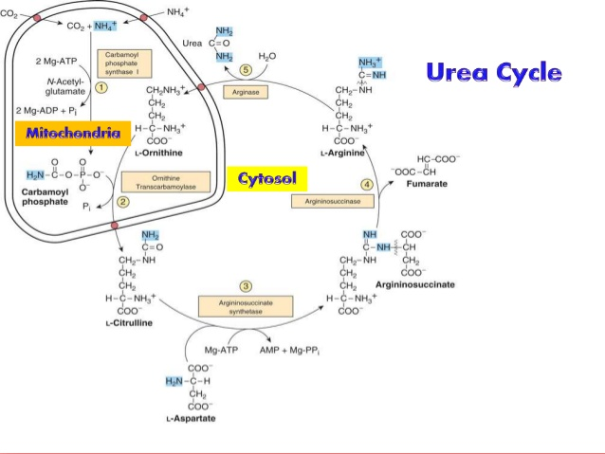

Slide 20
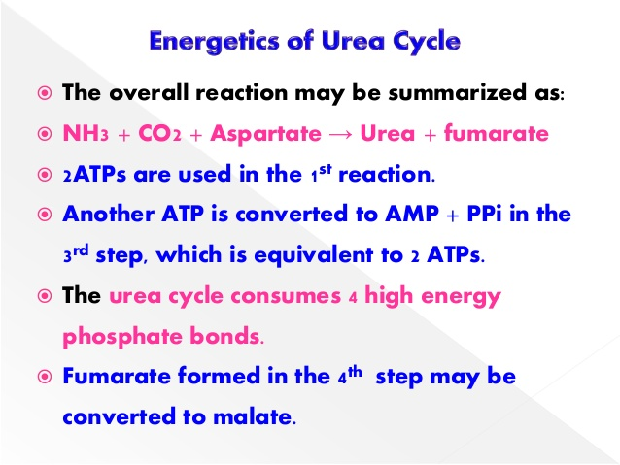

Slide 21
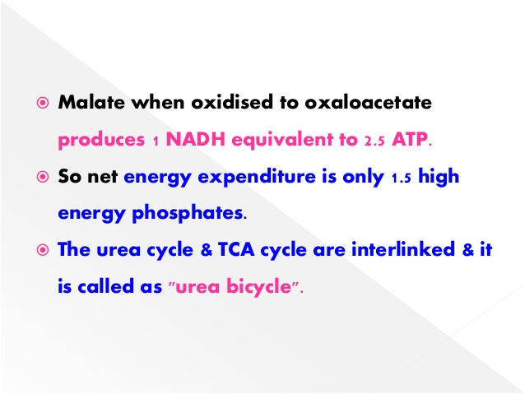

Slide 22
Significance of Urea Cycle
The Urea cycle or the 'Ammonia detox cycle' is the process of removal of ammonia from the body.
Ammonia is the end product of protein metabolism, which is toxic to the human body, especially the CNS.
Hence, Ammonia is converted into a harmless water soluble compound called 'urea' which is expelled through urine.

Slide 23
